Slide 1
Wabash Capstone
Project Notes 04
By: John Danison

Slide 2

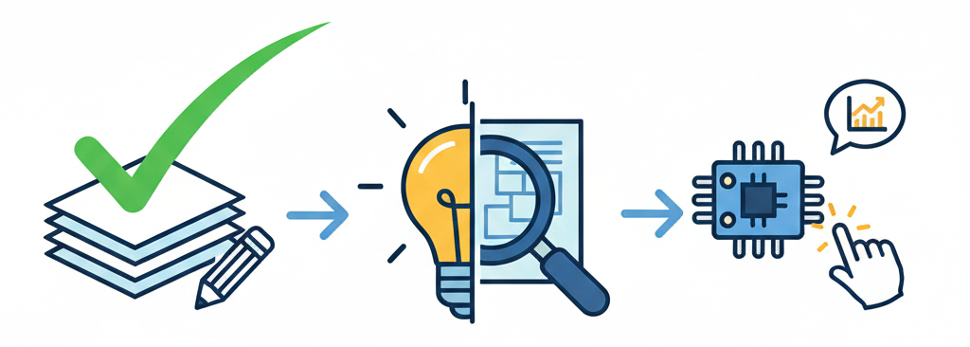
What Have I Done This Week
Created Majority Of Slide Show For Gate Report 1.5
Presented the Existing Solutions & Exploratory Concepts
Started Researching Actual Sensors To Use

Slide 3
Did I Do What I Say I Would Do?
As usual, I feel that I met my promises this past week.
There is nothing outstanding where I am holding my group back from making progress.
I have attended every class so far. I continue to lead the EE & DAQ of this project.

Slide 4
Plans For Upcoming Week
Continue To:
Refine Data Acquisition Strategy | Specifically How Data Will Be Formatted
Research Exact Sensors We Are Going To Use
Communicate with Team Members
By EOW:
Have Sensors Picked
Read Through Wabash Documentation For Understanding and Analysis

